Slide 1
Business Office Training
October 2016

Slide 2
Travel Reimbursements

Slide 3
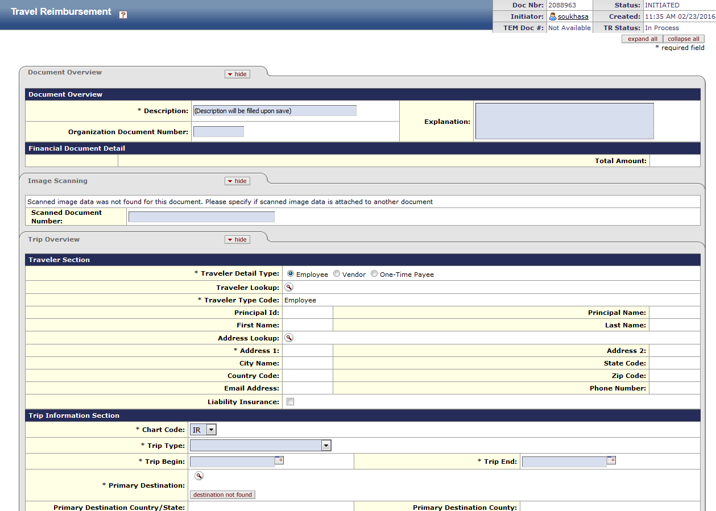
Submit expenses within 45 days of travel
Name of the Traveler
Who
Ex: Travel for Joe Smith to USITT (United States Institute for Theater Technology) conference held from March 16-19, 2016, in Salt Lake City, attended for professional development.
What
When
Where
Include the travel dates in the trip begin and trip end fields. The actual conference date should be in the explanation field. Include a note if travel dates differ from conference.
Why
http://admin.arts.uci.edu/content/financial

Slide 4
Airfare: Include the Ticket Number, Cabin Type, and Breakdown of Fare
Lodging: Hotel folios or similar receipt with dates of stay, room charge, and taxes
Registration Fees: A brochure or document regarding the purpose and the total amount paid
Conferences: Include the agenda if attending or flyer/detail regarding a lecture being given
Car Rental: Include rental agreement number, total charge, and miles in/out
Mileage: Maps
For foreign nationals: The following completed forms must be attached to the check request:
Copy of passport
Copy of I-94 stamp on visa
Certification of academic activity (http://www.accounting.uci.edu/travel/resources/foreign.html)
There is a $74/day limit on reimbursements for food. The meal limit of $74 should not be treated as a per diem. Meal reimbursements should be limited to actual reasonable costs incurred up to the maximum of $74.
Supporting Documents Sent to Scanning
Note: Itemized receipts and proof of payment are always required.
If the receipt is for a meeting, indicate on the notes line the names of the people attending.
REMEMBER TO REDACT!!
http://admin.arts.uci.edu/content/spending-guide-faculty-staff-student

Slide 5
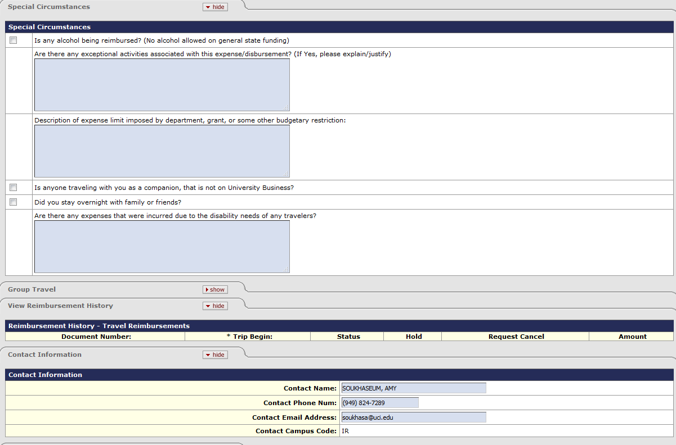
Complete the special circumstances tab if the situations apply.

Slide 6
Entertainment Reimbursements

Slide 7
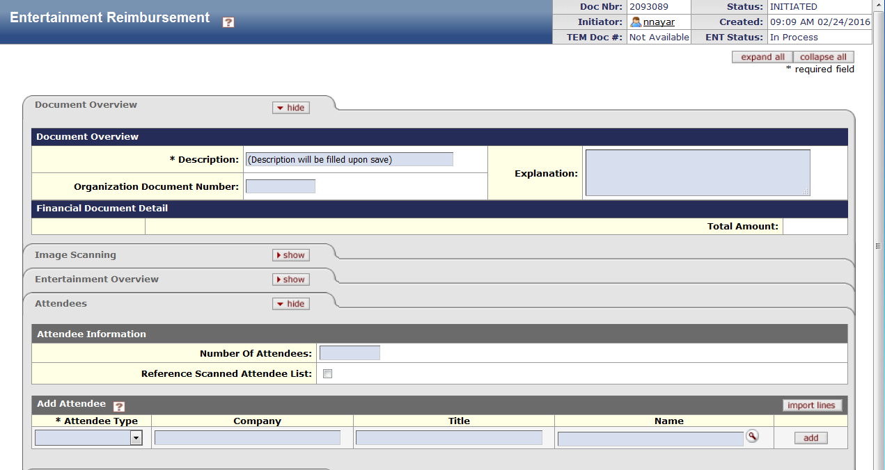
“In general, the University will not pay for or reimburse costs for meals taken with individual colleagues at the same work location unless the participants were unable to accomplish the business purpose during working hours”
The Athletics Department hosted a rock climbing safety event on June 1, 2016 at the Anteater Recreation Center (ARC) to educate students on proper technique to prevent injury. Light refreshments were served at the event.
Send attendee list to scanning (include title) or flyer of event if open to the public
Enter actual number or estimate if event is open to the public.
Check box if list sent to scanning. Otherwise, list attendees below.
http://admin.arts.uci.edu/content/financial

Slide 8
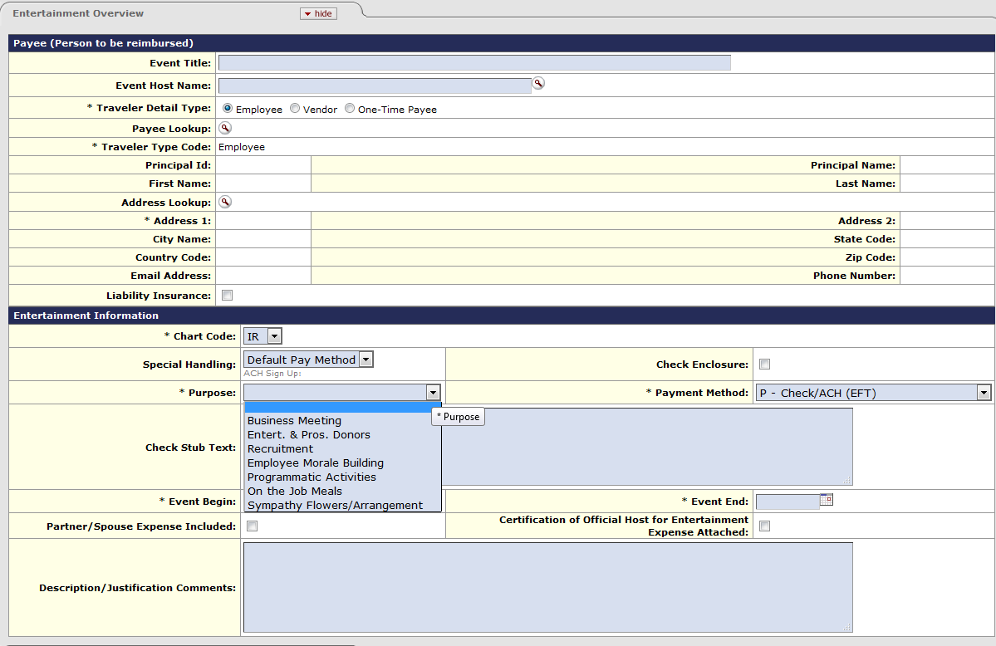
See University of California – Policy BUS-79 Expenditures for Business Meetings, Entertainment, and other Occasions for detailed descriptions of each purpose type.
Note: For imported expenses, the per person amount should be manually calculated and listed in the line description.
http://admin.arts.uci.edu/content/financial

Slide 9
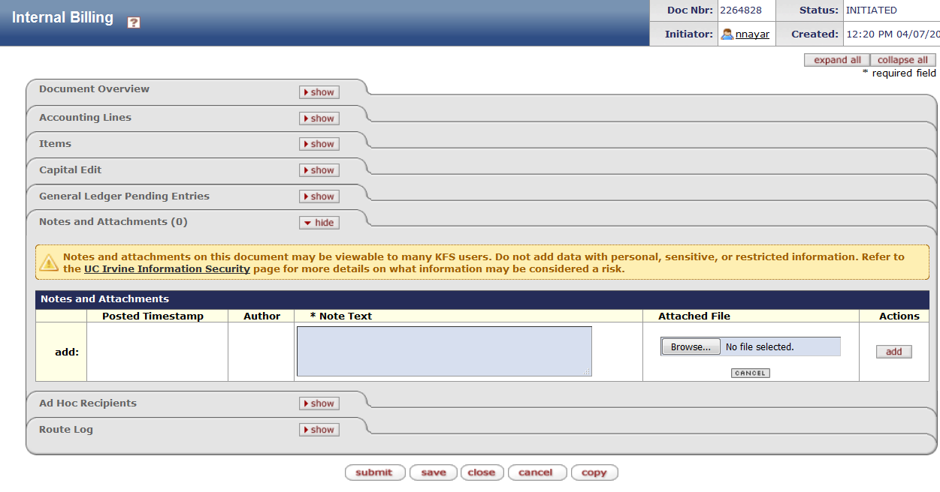
Add Project Code.
Attach back-up for Internal Billing.

Slide 10
Disbursement Vouchers

Slide 11
Disbursement Vouchers
Payment Reason Codes:
A: Prizes and Cash Awards L: Non-Travel Registration
C: Payment to Research Participant O: Agency Agreements and Contracts
E: Honoraria P: Fees, Licenses, Employee Tuition
G: Utilities, Freight, Postage, Storage Q: Program Sponsorships
I: Memberships, Subscriptions, and Dues U: Gifts & Non-Cash Awards
B: Emergency Purchases (Supplies & Materials)
“The Return to Initiator button will be used beginning July 1st, for DVs that do not include an explanation as to why the purchase did not follow the correct purchasing protocol.”
Per UC policy, any employee who buys goods without Low Value Purchase Authority is making an unauthorized purchase. As a public entity, UCI requires certain protocols and approvals are in place for all purchase transactions. Using personal funds to circumvent protocols to acquire goods and services is not acceptable unless it is a business emergency.
*Review the Purchasing Methods Guide for guidance on proper purchasing protocol.*
http://admin.arts.uci.edu/content/spending-guide-faculty-staff-student

Slide 12
PalCards

Slide 13
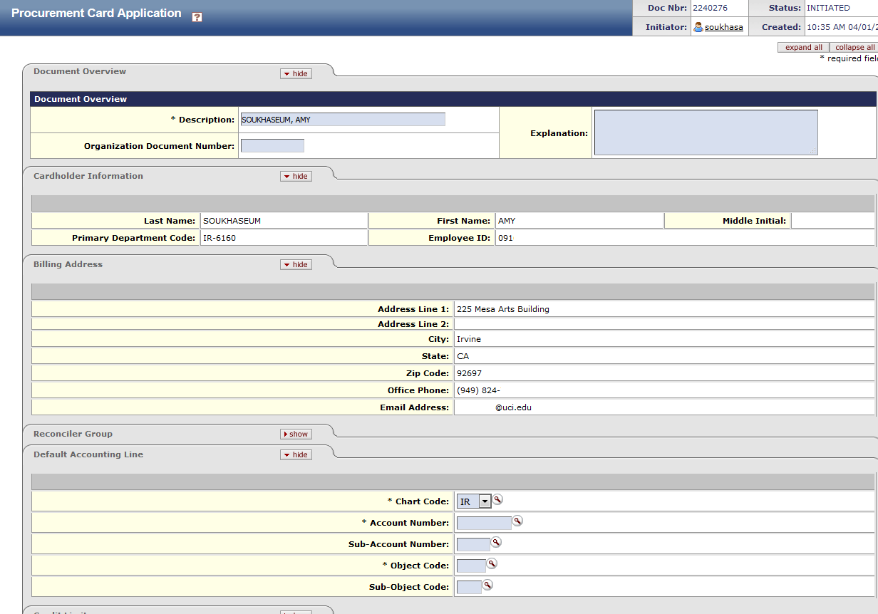
Obtaining a PalCard
You must complete the electronic training and pass the PalCard e-test
Once you complete the PalCard e-test, print the confirmation page and start the application process. Refer to the Business Office website for link.
You will need to upload a copy of the confirmation showing you have passed the test under “Notes and Attachments”
Automatically generated
Ask supervisor for accounting information
http://admin.arts.uci.edu/content/palcard-process

Slide 14
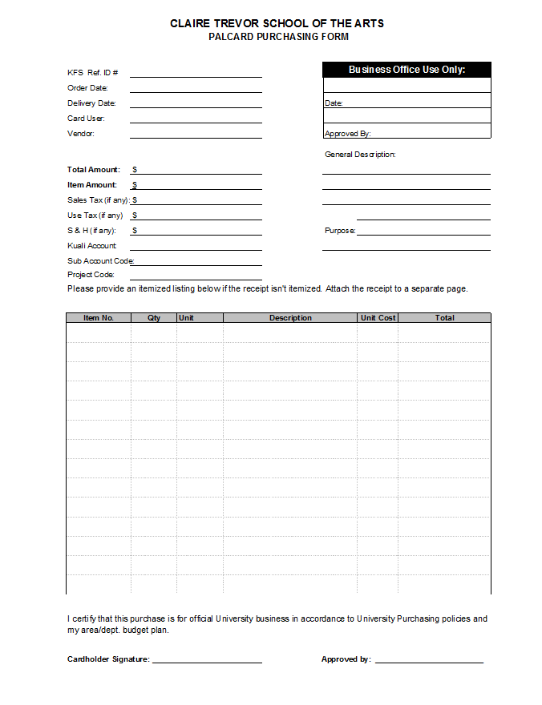
Calculating use tax:
Tax rate is 8%.
If the invoice says shipping or freight, take 8% of the subtotal.
If the invoice says shipping and handling, take 8% of the grand total
Fraudulent Charges:
If a fraudulent charge occurs, please contact purchasing immediately so they can assist with canceling and reissuing
Complete a PalCard requisition form for initial charge and credit
In the general description box, please write “Fraudulent charge”
KFS Account number is your default account
If unknown leave blank and Business Office will complete
General Description: Screws, bolts
Purpose: Used to build the set of New Swan (MacBeth)
http://admin.arts.uci.edu/content/palcard-process

Slide 15
Supporting Documentations
Itemized receipt and proof of payment
Packing slip with the amount written in
Invoice from the merchant
Screen print from an internet order
Email confirmation
Conference registration form or fax order form
Restricted Goods and Services
Employee or non-employee gifts (recognition, staff awards, retirement, bereavement)
Travel expenses such as airfare, hotel & car rental
Meals, food, beverages or snacks
Furniture
Charitable contributions to organizations
Personal purchases
eBay and Etsy are considered an internet auction site, regardless if you bid on an item or if you purchase it outright as a "Buy-It-Now." Any purchases made from a seller with an "eBay Storefront" do not comply with policy.
**Always refer to the Purchasing Methods Guide**
http://admin.arts.uci.edu/content/palcard-process

Slide 16
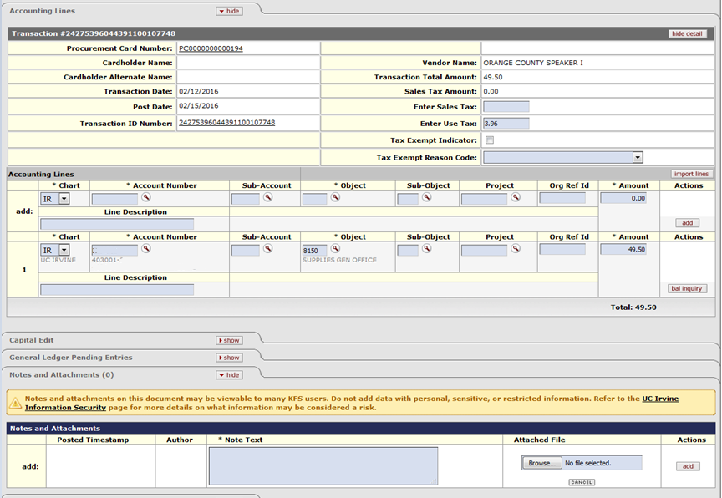
Attach Palcard forms here
http://admin.arts.uci.edu/content/palcard-process

Slide 17
Late Palcard Procedure:
Every PalCard holder should be getting notifications in your Action List, on KFS, a few days after your purchase. Once you get the notification in your Action List, you have 5 days to turn in all supporting documents to the Business Office. If we do not receive your paperwork within 5 days, we will be sending you an email (1st email). You will receive a second email if we have not received your paperwork within 2 days of the 1st email. If a 3rd email is sent stating we have not received your documentations, this will count as 1 late Palcard towards your 3.
If we still do not receive any documentations after the 3rd email and the Palcard automatically goes to the General Ledger this is considered late. From here you will have 2 late PalCards.
What happens after 3 late Palcards? Your Palcard will be placed on hold until you retake the test (please send results to Amy Soukhaseum). Your next late PalCard violation will result in the revocation of your card.
http://admin.arts.uci.edu/content/palcard-process

Slide 18
Requisitions/Purchase Orders

Slide 19
Requisition Process Flow
Requisition Created/Contract Sent to Purchasing** (Attach Quote/Draft Contract)
Contract Routes to Contract Manager for Approval
Purchase Order (PO) Created and Emailed/Faxed to Vendor
Vendor Emails Invoice with PO Number to Accounts-Payable@uci.edu
**If invoice is added on the requisition, it does not route to accounts payable for payment.
http://admin.arts.uci.edu/content/spending-guide-faculty-staff-student

Slide 20
Performance Agreement Steps if:
UNDER $2,000.00
Submit the Performance Agreements to the Business Office and we will coordinate the signatures from the Dean.
Create KFS Requisition/PO and attach the Performance Agreement with all the signatures to the notes section
Email the performance agreement with all signatures to contracts@uci.edu (Including the words, "PERF AGRE UNDER $2,000“ and requisition number in the subject line to expedite the processing).
Email the invoice to Accounts Payable (accounts-payable@uci.edu) for payment to be processed
Include payee name, remit address, PO # and invoice # on invoice

Slide 21
Performance Agreement Steps if:
OVER $2,000.00 (These must have the Director of Purchasing's signature as the final approval)
Create KFS Requisition/PO and attached a drafted version in the notes section
Concurrently send the draft of the Performance Agreement to contracts@uci.edu for edits/review
Once approved for language and content by Contracts, they will provide a version that can be circulated for signatures
Obtain signatures from the Artist/Artist's Agent; then the Dean before returning it to contracts@uci.edu for the Director of Purchasing's (or AVC in the case that it is over $25,000.00) approval
Once the Director of Purchasing signs, Contracts will append to the KFS PO and then approve the KFS PO
Contracts will send a confirmation email
Email the invoice to Accounts Payable (accounts-payable@uci.edu) for payment to be processed
Include payee name, remit address, PO # and invoice # on invoice

Slide 22
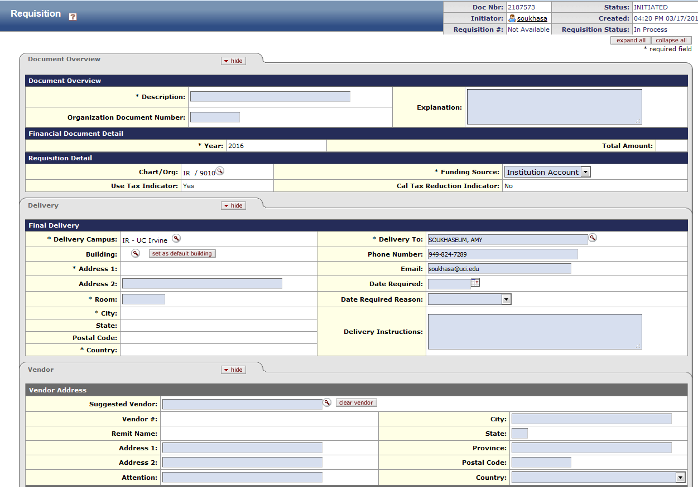
Enter “C/A” and Vendor Name
Example: C/A John Smith
Explanation should include who, what, when, where, and why
http://uclc.uci.edu/

Slide 23
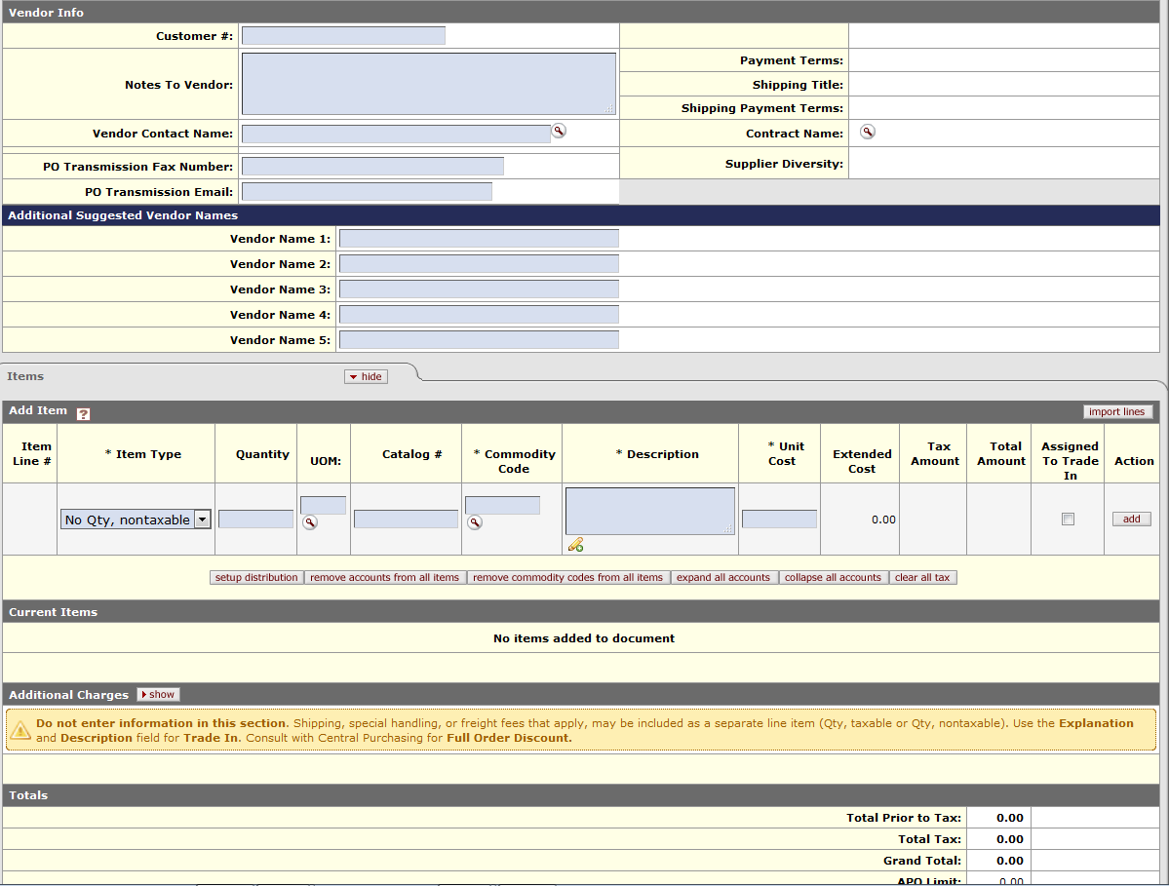
Use commodity code: 82150000
Select No Qty, nontaxable
http://uclc.uci.edu/

Slide 24
Questions?

